Slide 1

Analyzing the Relationship Between Blood Pressure, Cholesterol, and Cardiovascular Disease
By: Nathanael Ochoa
DSC680 - Project 2
February 2, 2025

Slide 2
Topic Overview
Background History
Research on blood pressure, cholesterol, and cardiovascular disease.
High blood pressure and cholesterol are linked to heart disease.
Personal connection due to family history/health.
Cardiovascular diseases are the leading cause of death worldwide.
18 million deaths in the year 2019.
High cholesterol and lifestyle factors increase heart disease risk.

Slide 3
Research Questions
Is there an increased risk of cardiovascular disease for individuals with high blood pressure?
Is there an increased risk of cardiovascular disease for individuals with high cholesterol levels?
How do factors like smoking and alcohol affect risk?

Slide 4
Data Explanation
Dataset from Kaggle: 70,000 records from medical exams.
Binary target variable indicating cardiovascular disease presence.
Also contains variables for systolic blood pressure, diastolic blood pressure, glucose, smoking, alcohol intake, and physical activity.

Slide 5
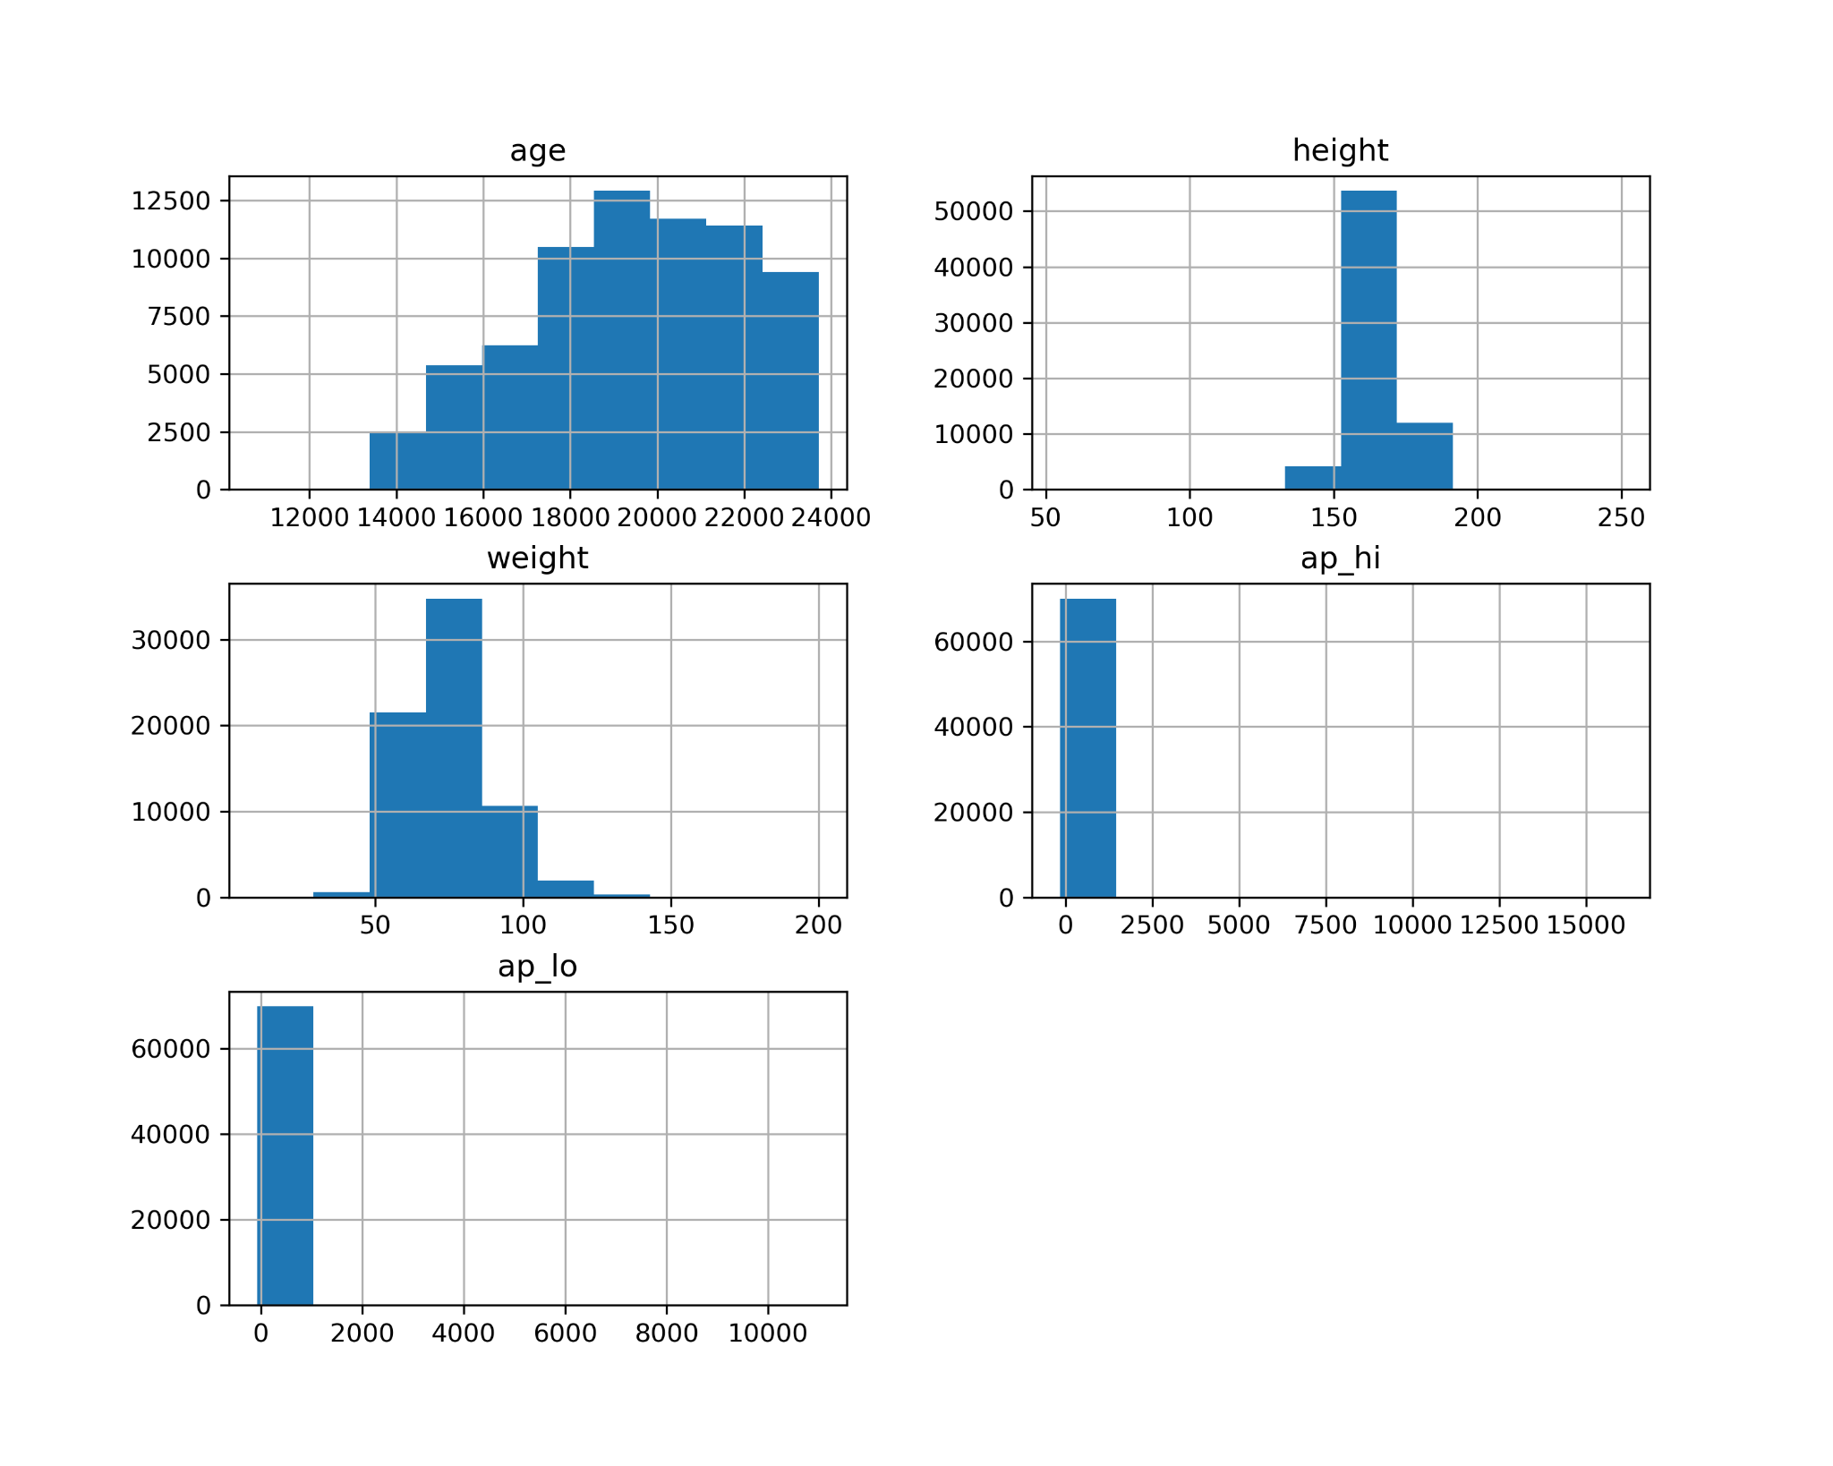
Methods
Exploratory Data Analysis (EDA) for insights.
Correlation analysis with Pearson, Point-Biserial, and Chi-Squared tests.
Logistic Regression and Random Forest for modeling.

Slide 6
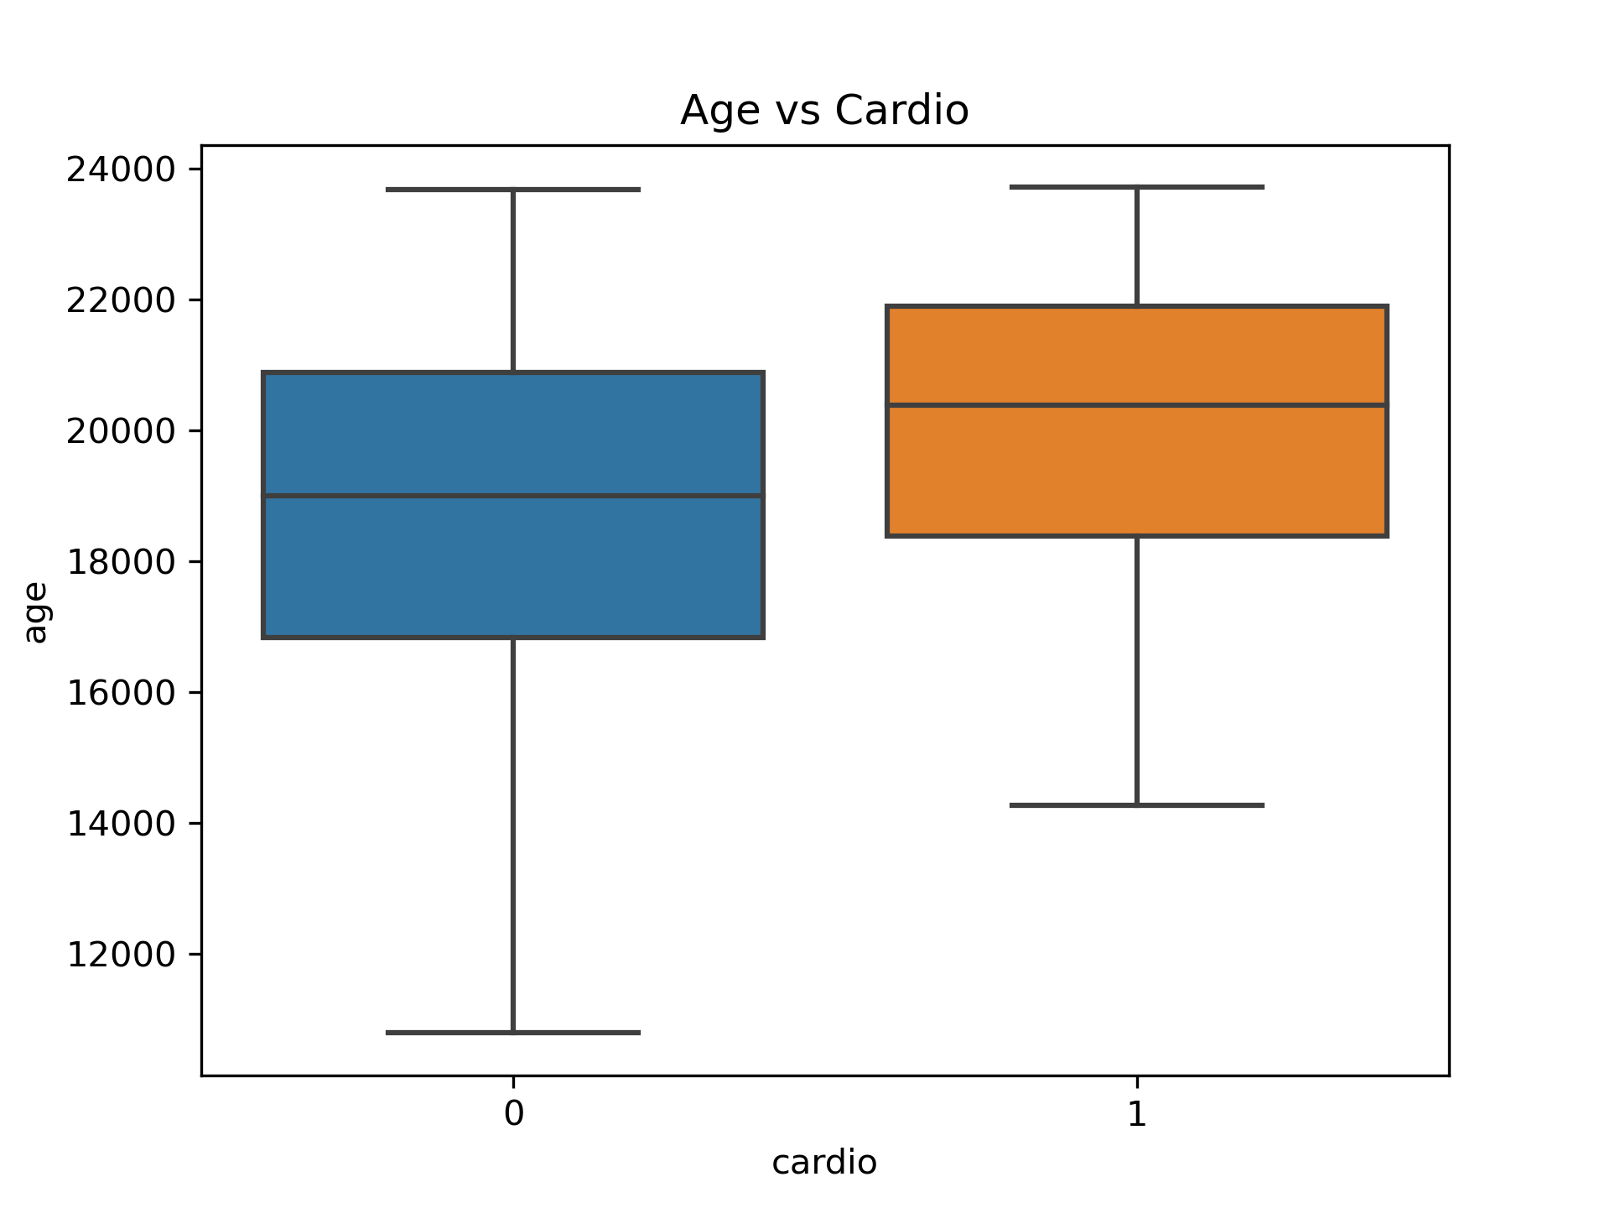
Box Plot Analysis
Outliers present in cardiovascular disease group.
Overall, the two groups share similar ranges in data.

Slide 7
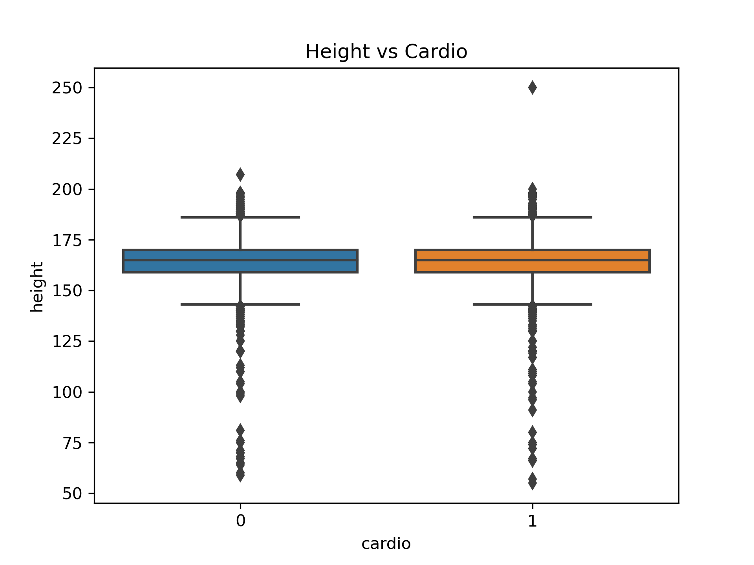
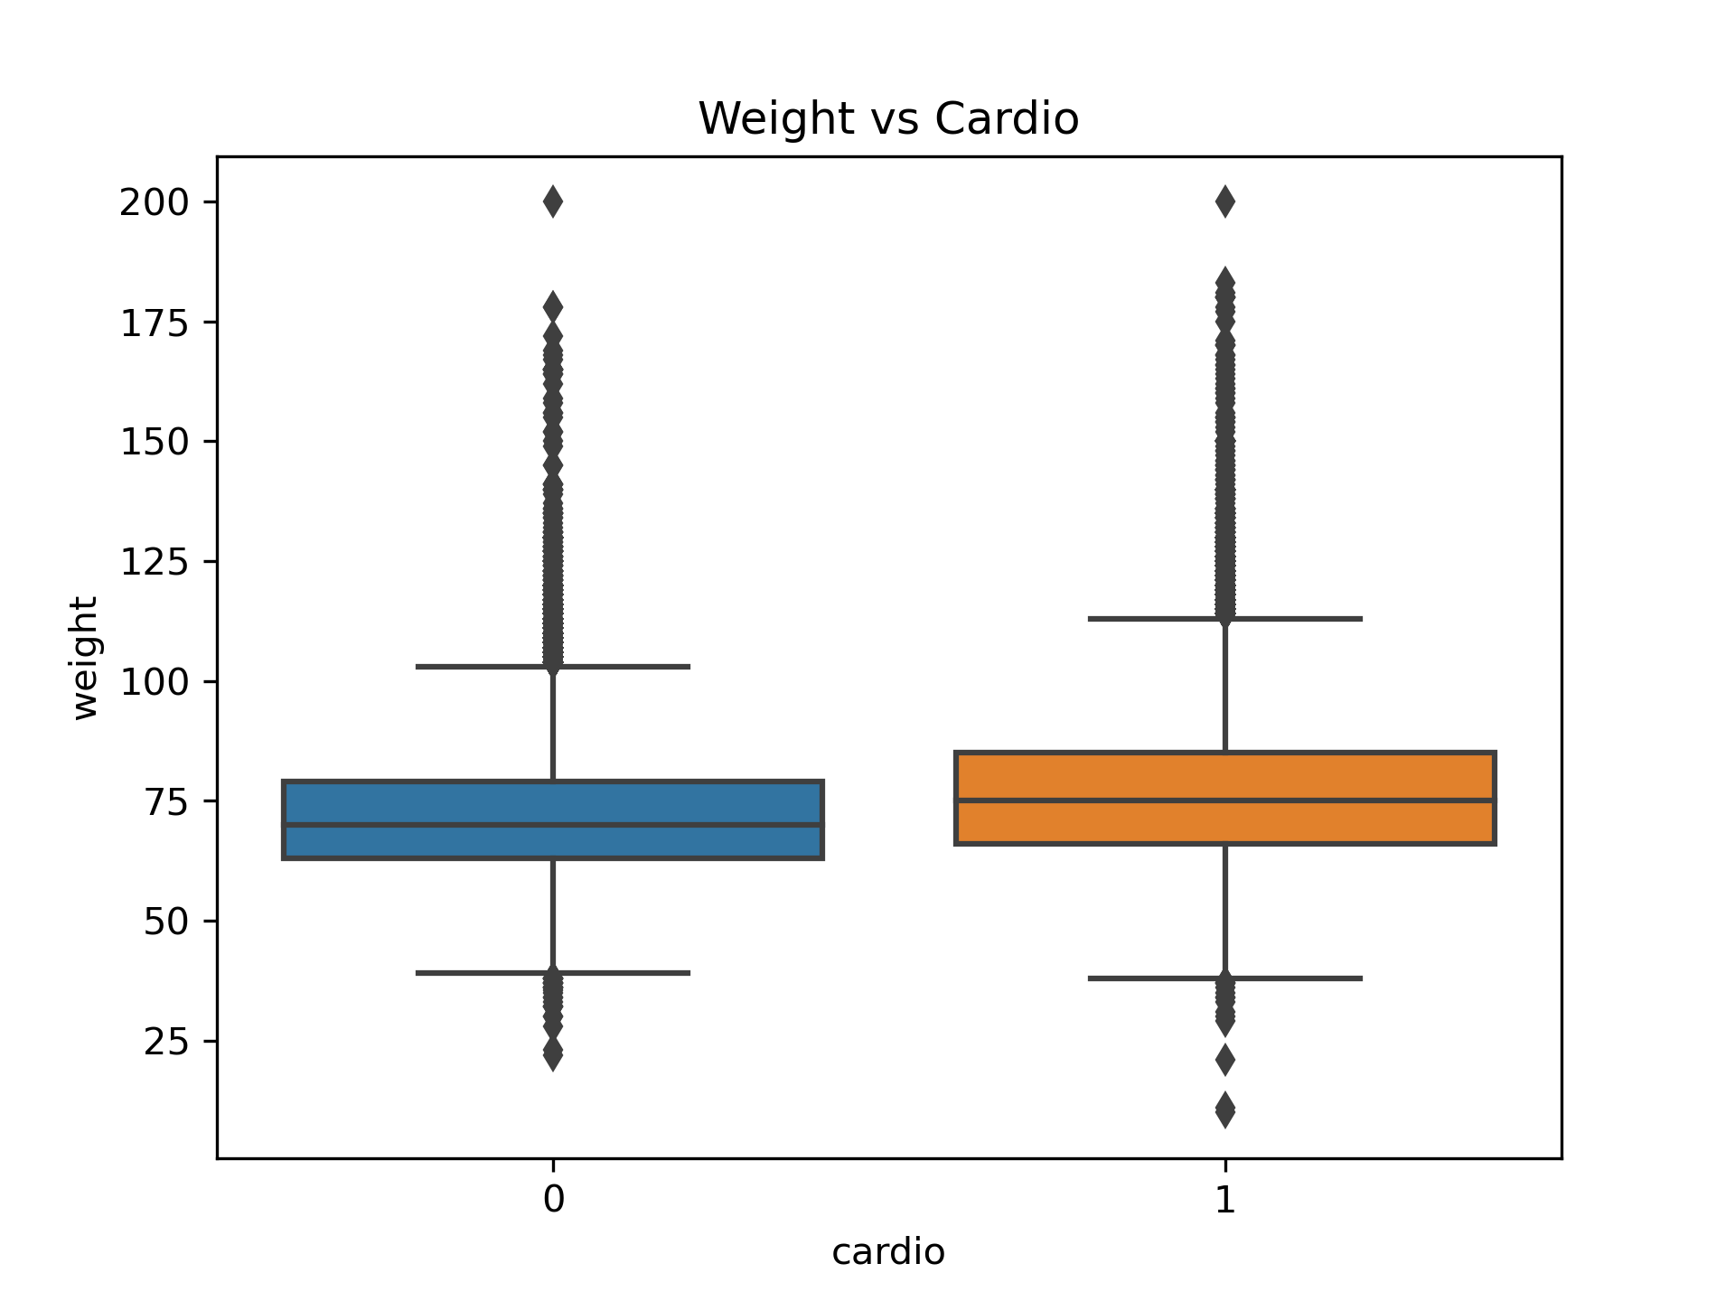
Box Plot Analysis Cont.

Slide 8
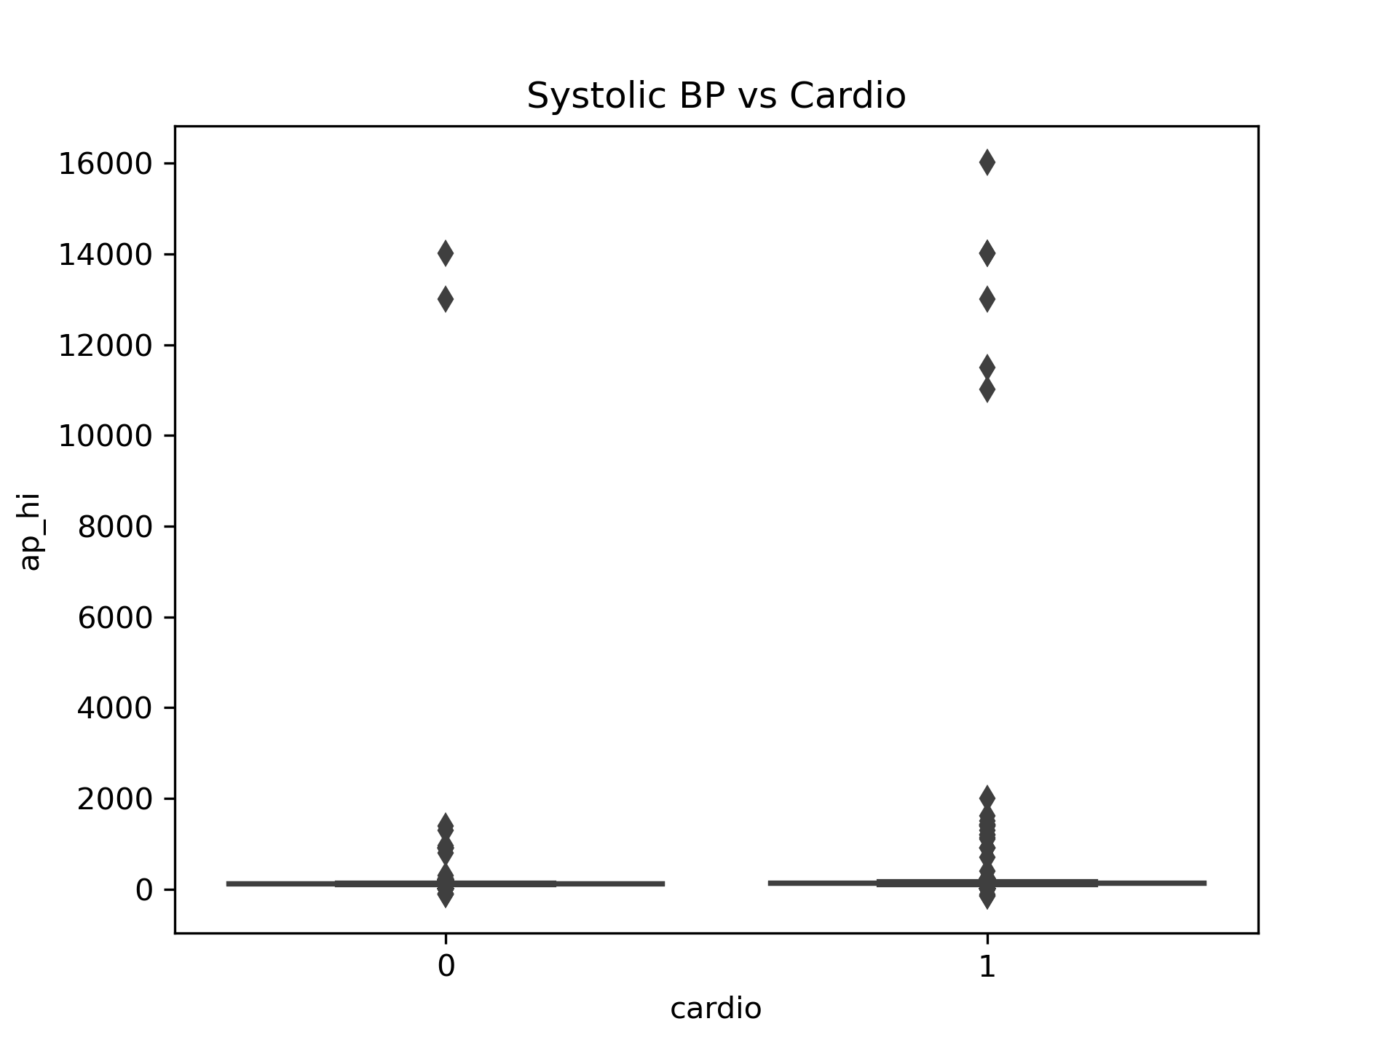
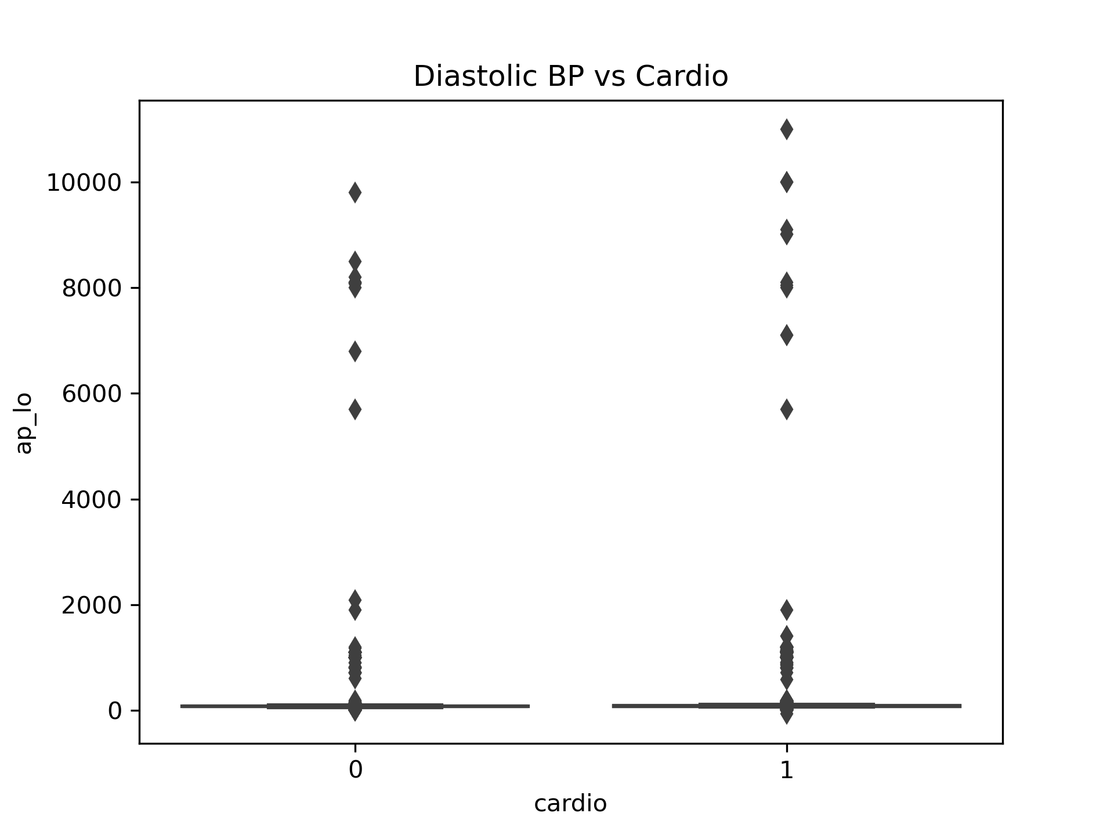
Box Plot Analysis Cont.

Slide 9
Pearson Correlations
id: 0.003799
age: 0.238159
gender: 0.008109
height: -0.010821
weight: 0.181660
ap_hi: 0.054475
ap_lo: 0.065719
cholesterol: 0.221147
gluc: 0.089307
smoke: -0.015486
alco: -0.007330
active: -0.035653
cardio: 1.000000
Age and cholesterol are the strongest predictors of cardiovascular disease.
Other factors like weight and glucose show weaker correlations.

Slide 10
Chi-Squared Test
gender: 0.03254570031936317
cholesterol: 0.0
gluc: 3.5786568357289105e-128
smoke: 4.4293623605077656e-05
alco: 0.05452518218322108
active: 4.3651927285329286e-21
Significant predictors: gender, cholesterol, glucose, smoking, and physical activity.
Alcohol intake is marginally non-significant.

Slide 11
Point-Biserial Correlation
smoke: -0.015485935661367646
alco: -0.007330231723203043
active: -0.03565324811518846
Smoking and physical activity show weak but significant correlations.
Physical activity associated with a reduced cardiovascular disease risk.

Slide 12
Logistic Regression Model
Accuracy: 69.81%
Strong Predictors: systolic blood pressure, weight, and cholesterol.
Minimal impact from glucose and diastolic blood pressure.
ap_hi: 0.037099
weight: 0.020972
cholesterol: 0.002726
gluc: 0.000461
ap_lo: 0.000381
age: 0.000107
gender: 0.000076
smoke: -0.000036
alco: -0.000038
active: -0.000821
height: -0.050816

Slide 13
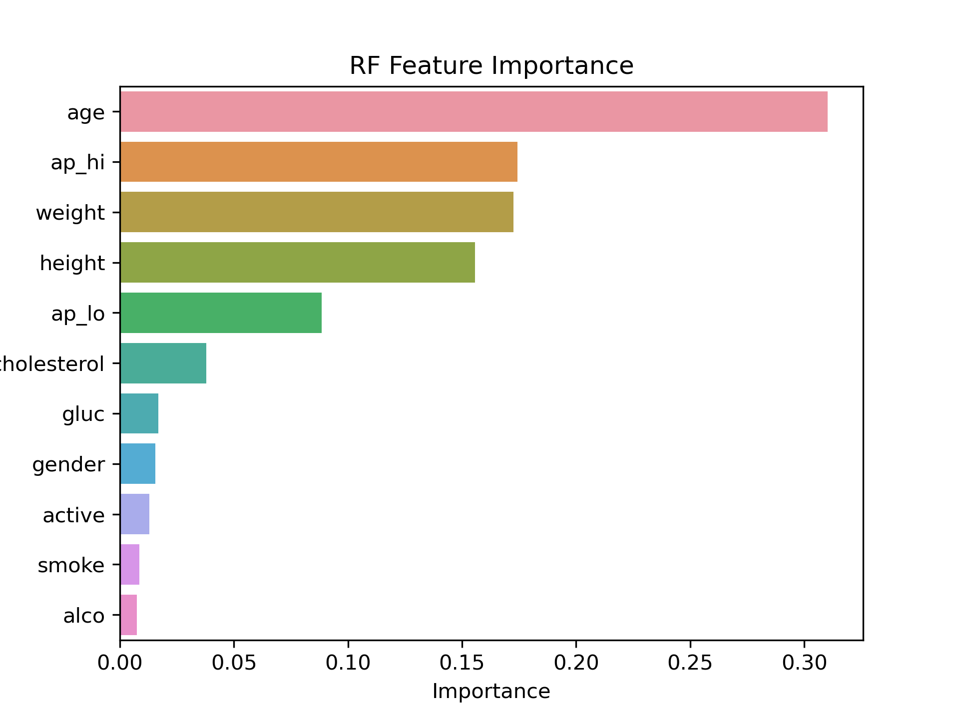
Random Forest Model
Accuracy: 71.43%
Most important predictors: age, systolic blood pressure, and weight.
Cholesterol, diastolic blood pressure, and height also contribute.

Slide 14
Conclusion
Age, cholesterol, and systolic blood pressure are key predictors.
Lifestyle factors like smoking and physical activity have weaker influences.

Slide 15
Assumptions
Limitations
Assumed ethical sourcing of data.
Patient data assumed to be truthful.
Lack of specific cholesterol values(HDL/LDL).
Missing variables like sodium intake and sunlight exposure.

Slide 16
Future Uses/Additional Applications
Recommendations
Dataset can be expanded with more variables.
Potential for future research and updates to the analysis.
Add variables like sodium intake and specific cholesterol levels.
Consider starting a new survey for updated data.

Slide 17
Ethical Assessment
No ethical concerns; no personal data involved.
Dataset was ethically sourced on my end and publicly available.

Slide 18
Thank You
Thank you for your attention.
Any Questions?

